Slide 1

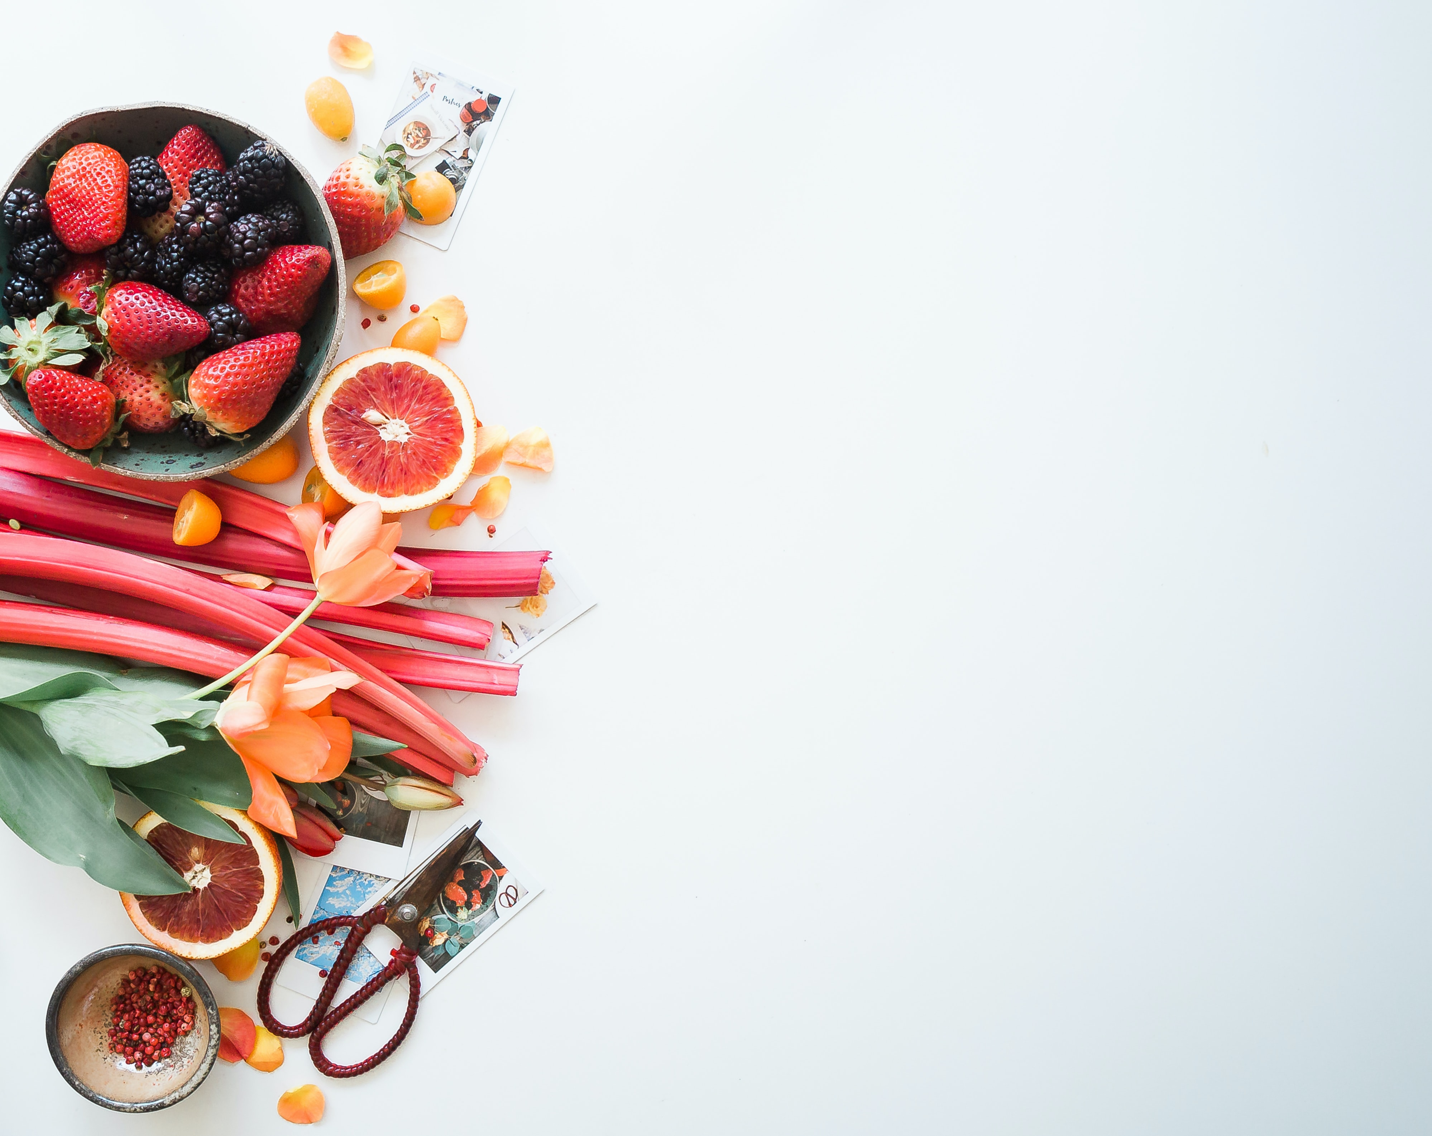

A Convolutional Neural Network application for a
Food Image classification task
Foto di Brooke Lark su Unsplash

Slide 2
Summary of the project
List the group members
Introduce the problem you are trying to solve
Show an analysis of the available data
Describe your solution
Comment positive and negative results of your solution (rely on quantitative and qualitative observations)
Describe alternative (possibly failed) experiments

Slide 3
Summary of the project
List of the group members
- Alessandro Maccario (Badge number: 865682)

Slide 4
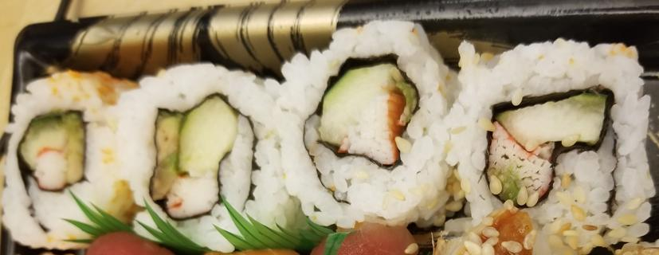
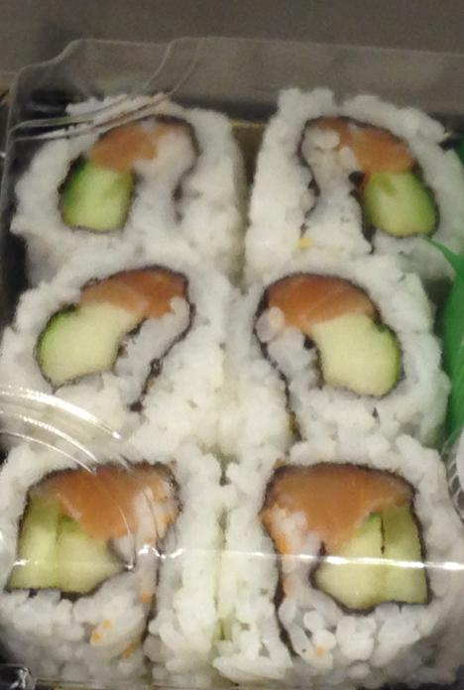
2. Introduce the problem you are trying to solve
Image Food classification is the process of identifying the type of food contained in an image. It is a challenging problem due to the wide variety of food items that exist and the variations that can occur within each type of food. Deep neural networks have proven to be effective for solving a variety of image classification tasks, including food classification.
CNN are particularly well-suited for image classification tasks because they can learn features from images and identify patterns and characteristics that are relevant for classification;
One of the problem encountered in this specific project is that for some categories (sushi and sashimi, for instance) the features to be learned are similar to each other and therefore is not simple, even for a human, to be able to distinguish those two types of food.
sushi
sashimi
Notes:
A food classification problem in Deep Learning is a type of problem where the goal is to accurately classify food items into predefined categories. This might involve categorizing different types of fruits, vegetables, meats, or other types of food into specific classes.
To solve it, you would typically start by collecting a large dataset of images or other types of data that represent different types of food. In this specific project it will be used the Example Food Images data set that contains 978 photographs of food in nine classes.
The literature suggests to use a Convolutional Neural Network (CNN) Deep Learning architecture in order to recognize and classify different types of food based on the input data, because they are particularly well-suited for image classification tasks. This is because CNNs are designed to automatically learn features from images and identify patterns and characteristics that are relevant for classification.
Once the model has been trained, it can then be use it to classify new images or other types of data and predict which class each food item belongs to.
This output can be useful in a variety of applications, such as creating a food recognition app that helps people identify different types of food, or developing a system that can automatically sort and organize food items in a warehouse or grocery store.

Slide 5
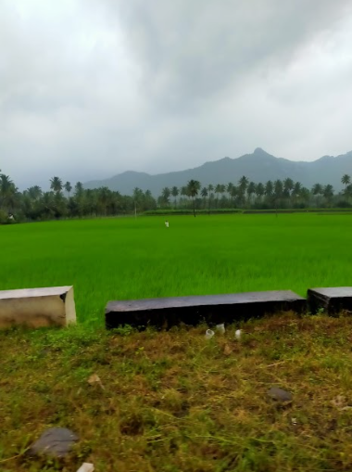
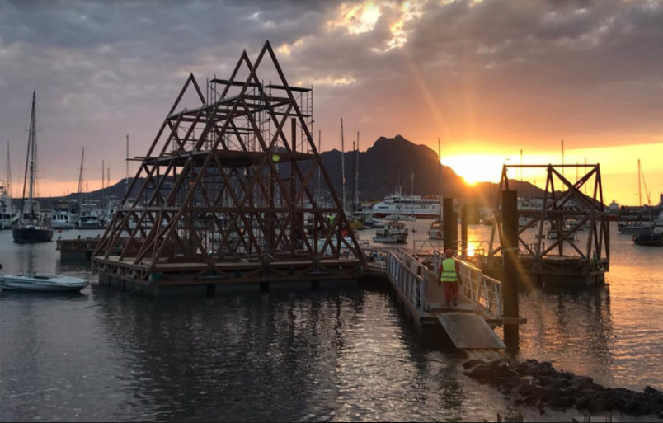
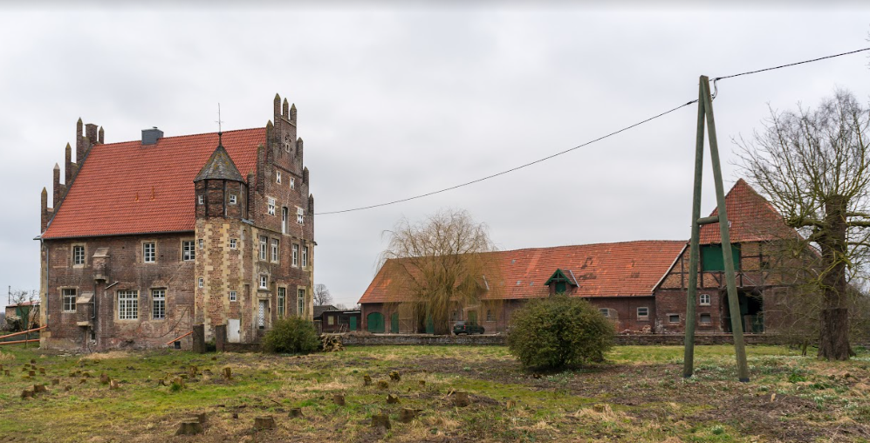
2. Introduce the problem you are trying to solve
In order to consider a rejection class, a script have been created to download images under free licenses (mostly Creative Commons, attribution-Share-Alike) from Wikimedia Commons.
Some sample images are shown below, adding another categories to the one already given by the original dataset:
https://en.wikipedia.org/wiki/Wikipedia:Ten_things_you_may_not_know_about_images_on_Wikipedia
https://en.wikipedia.org/wiki/Wikipedia:File_copyright_tags#For_image_creators
Notes:
A food classification problem in Deep Learning is a type of problem where the goal is to accurately classify food items into predefined categories. This might involve categorizing different types of fruits, vegetables, meats, or other types of food into specific classes.
To solve it, you would typically start by collecting a large dataset of images or other types of data that represent different types of food. In this specific project it will be used the Example Food Images data set that contains 978 photographs of food in nine classes.
The literature suggests to use a Convolutional Neural Network (CNN) Deep Learning architecture in order to recognize and classify different types of food based on the input data, because they are particularly well-suited for image classification tasks. This is because CNNs are designed to automatically learn features from images and identify patterns and characteristics that are relevant for classification.
Once the model has been trained, it can then be use it to classify new images or other types of data and predict which class each food item belongs to.
This output can be useful in a variety of applications, such as creating a food recognition app that helps people identify different types of food, or developing a system that can automatically sort and organize food items in a warehouse or grocery store.

Slide 6
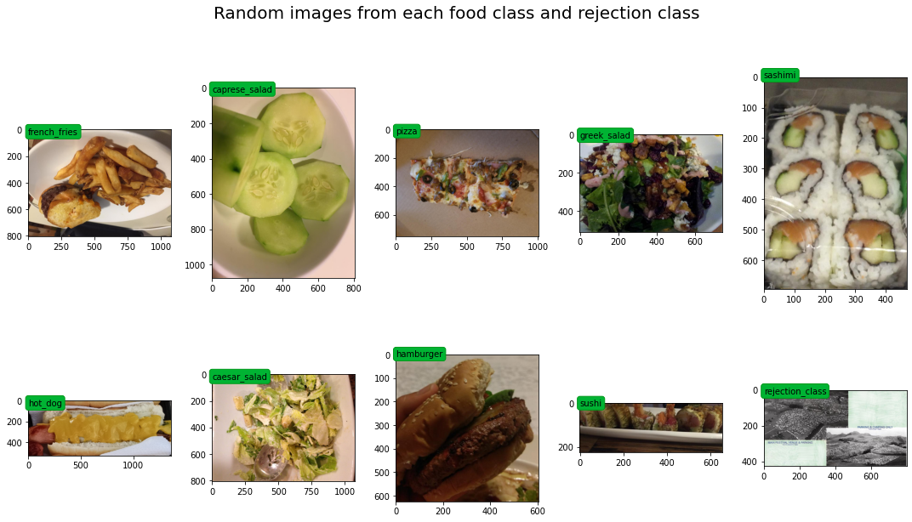
3. Show an analysis of the available data
In this picture it is possible to see different food classes for the problem at hand. The pictures available are also in different shapes, for instance:
french_fries: (756, 1008, 3)
caprese_salad: (1078, 808, 3)
pizza: (782, 1056, 3)
greek_salad: (159, 212, 3)
sashimi: (389, 422, 3)
hot_dog: (1650, 1081, 3)
caesar_salad: (808, 1078, 3)
hamburger: (549, 502, 3)
sushi: (808, 1078, 3)
rejection_class: (426, 800, 3)
Before feeding them into the models, the preprocessing procedure involves a resizing of the images.

Slide 7
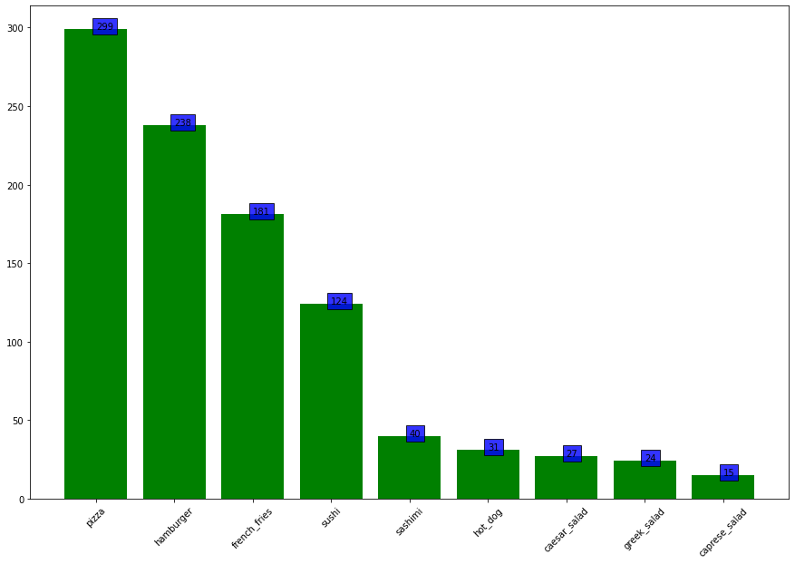
3. Show an analysis of the available data
The Example Food Images data set is divided in 9 different categories, such as Caesar salad, caprese salad, French fries, Greek salad, Hamburger, hot dog, pizza, sashimi, and sushi. It contains 978 photographs of food and the size of the data set is about 77 MB.
The problem itself is an unbalanced problem, that is the number of examples in different classes is not equal. The model in this case can have difficulties to learn the classes with fewer data points. In order to overcome this problem a Data Augmentation technique have been performed, obtaining 200 images for each category on the training set.
The training set contains 2003 images, the validation 242 images and the test set 193 images.

Slide 8
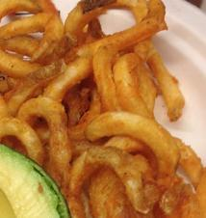
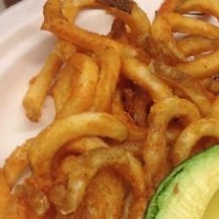
3. Show an analysis of the available data
In order to overcome the previous challenge, a data augmentation procedure has been applied in order to create sligtly different copies of the data right after separating the data in training, testing and validation folders. The training folder has been augmented reaching 200 images for each classes, before feeding the data into the model. The augmentation procedure involved horizontal and vertical flipping, brightness and hue modification.
Original fries image
Horizontal flip of fries image

Slide 9
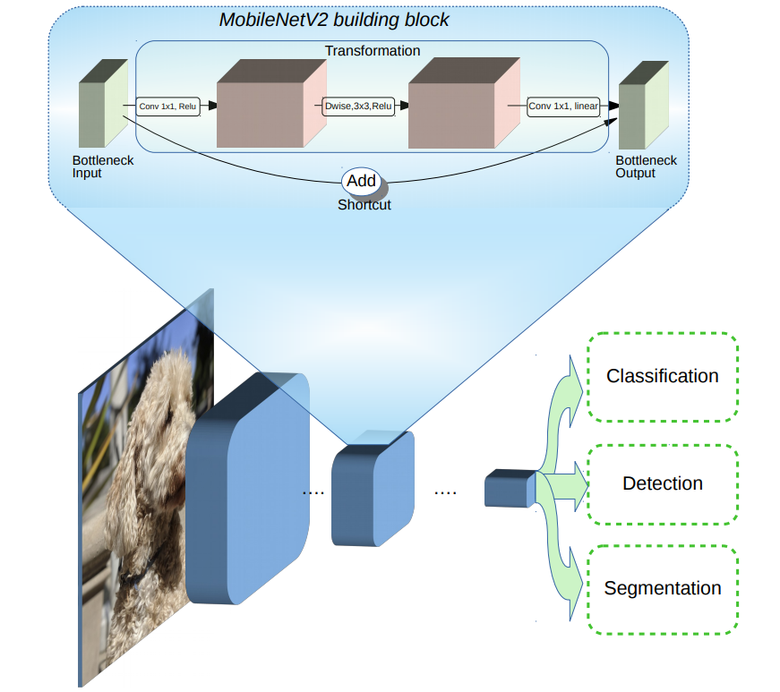
4. Describe your solution
The solution applied involved the usage of the MobileNetV2 (1) architecture pretrained on the Imagenet dataset (2) in order to use the concept of Transfer Learning, to apply the features learned by the model on another bigger dataset, on the one available in this project.
MobileNetV2 is a convolutional neural network (CNN), lightweight model that is well-suited for mobile and embedded applications, and can run efficiently on devices with limited computational resources.
Architecture
https://ai.googleblog.com/2018/04/mobilenetv2-next-generation-of-on.html

Slide 10
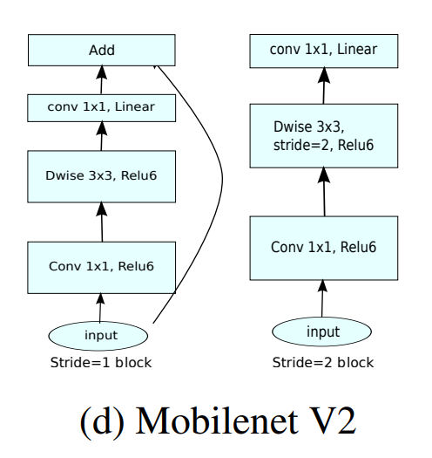
4. Describe your solution
The model involved a new layer called inverted residual with linear bottleneck
The inverted part of the name refers to the fact that the input and output connections are swapped compared to a traditional residual block. If in a traditional residual block, the input is added to the output of the block, in an inverted residual block the output of the block is added to the input.
The linear bottleneck refers to the use of a 1x1 convolutional layer, also known as a pointwise convolution, as a bottleneck to reduce the number of channels in the output of the block.
Architecture
https://arxiv.org/pdf/1801.04381v4.pdf
https://www.image-net.org/

Slide 11
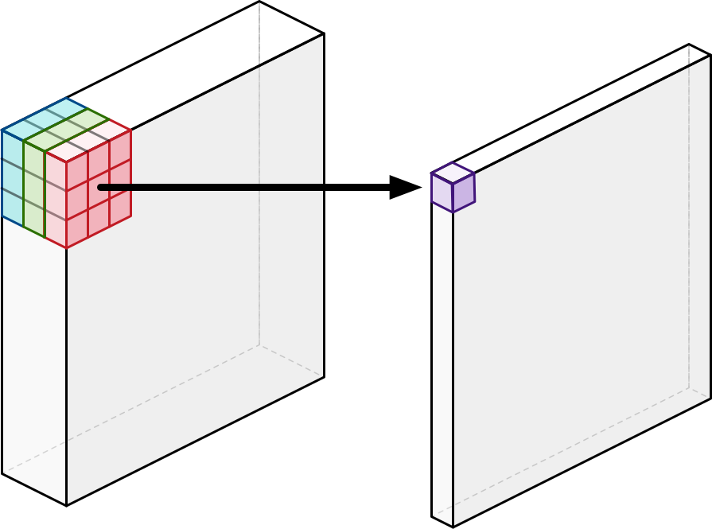
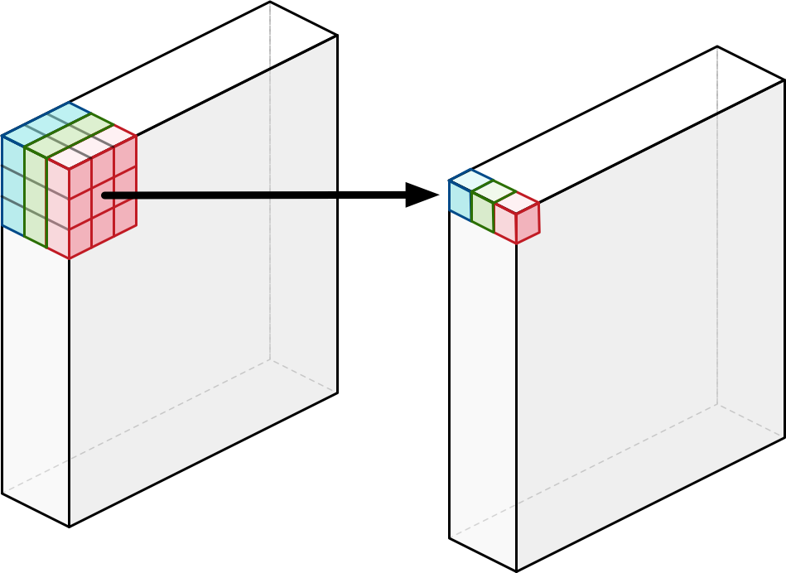
4. Describe your solution
The most important idea about MobileNets is that it uses depthwise separable convolutions to build light-weight deep neural networks. A regular convolutional layer applies a convolution kernel (or so-called filter) to all of the channels of the input image, sliding this kernel across the image and at each step and performing a weighted sum of the input pixels covered by the kernel across all input channels. The convolution writes a new output pixel with only a single channel.
The MobileNets architecture uses this standard convolution, but only as the very first layer. All other layers apply a depthwise separable convolution instead.
A main advantage is that with a depthwise separable convolution these two operations are done as separate steps. Both of the methods filter the data and make new features, but where a regular convolution has to do much more computational work to get to the final results and needs to learn more weights, the depthwise separable convolution is going to be much faster.
Regular convolutional
layer
Depthwise convolutional
layer
https://machinethink.net/blog/googles-mobile-net-architecture-on-iphone/
https://ai.googleblog.com/2018/04/mobilenetv2-next-generation-of-on.html

Slide 12
4. Describe your solution
This depthwise separable convolution is combination of two different operations:
depthwise convolution: the difference compare to a regular convolution is that it does not combine the input channels but it performs convolution on each channel separately. For an image with 3 channels, a depthwise convolution creates an output image that also has 3 channels. Each channel gets its own set of weights. The purpose of the depthwise convolution is to filter the input channels.
pointwise convolution: this is the same as a regular convolution but with a 1×1 kernel. In other words, this simply adds up all the channels (as a weighted sum). As with a regular convolution, we usually stack together many of these pointwise kernels to create an output image with many channels. The purpose of this pointwise convolution is to combine the output channels of the depthwise convolution to create new features.
Depthwise
convolution
Pointwise
convolution
https://machinethink.net/blog/googles-mobile-net-architecture-on-iphone/
Notes:
When we put these two things together — a depthwise convolution followed by a pointwise convolution — the result is called a depthwise separable convolution. A regular convolution does both filtering and combining in a single go, but with a depthwise separable convolution these two operations are done as separate steps.

Slide 13
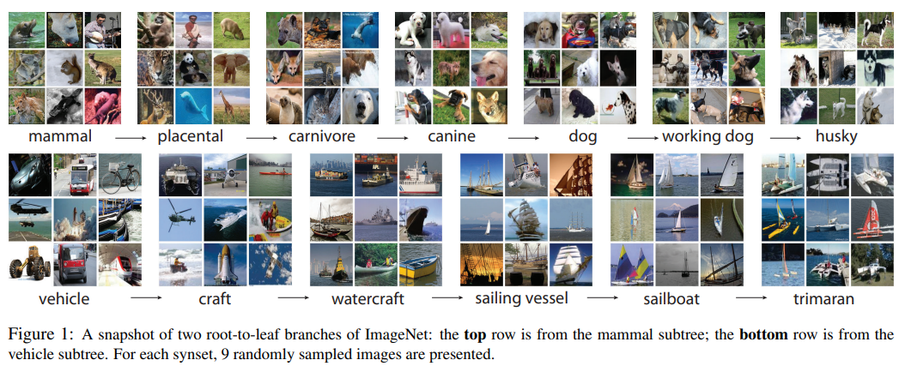

*In metadata, a synonym ring or synset, is a group of data elements that are considered semantically equivalent for the purposes of information retrieval.
https://en.wikipedia.org/wiki/Synset
4. Describe your solution
MobileNetV2 have been trained using the weights learned from the ImageNet dataset that contained 1000 classes.
ImageNet is defined as a largescale ontology of images built upon the backbone of the WordNet structure. It aims to populate the majority of the 80.000 synsets* of WordNet with an average of 500 - 1000 clean and full resolution images. This will result in tens of millions of annotated images organized by the semantic hierarchy of WordNet.
The last layer has been freezed and connected to another Dense layer with 512 neurons and then to the final Dense layer with the softmax activation function, in order to obtain the class probability distribution necessary to understand the prediction of the model.
https://machinethink.net/blog/googles-mobile-net-architecture-on-iphone/
https://www.image-net.org/static_files/papers/ImageNet_2010.pdf
Notes:
When we put these two things together — a depthwise convolution followed by a pointwise convolution — the result is called a depthwise separable convolution. A regular convolution does both filtering and combining in a single go, but with a depthwise separable convolution these two operations are done as separate steps.

Slide 14
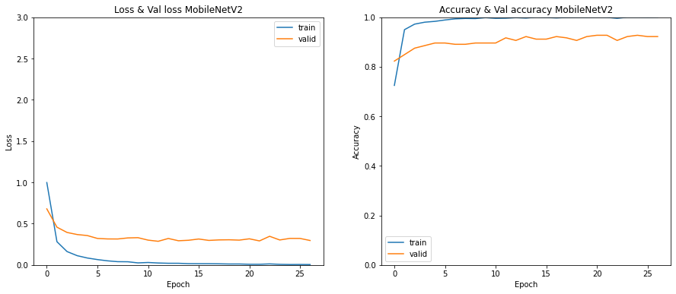
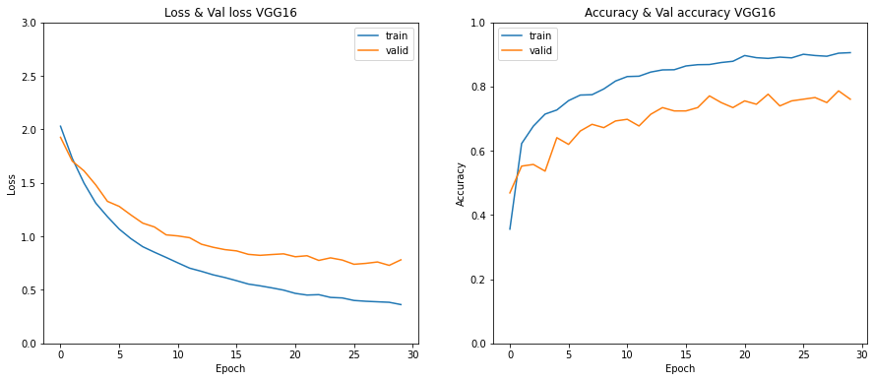
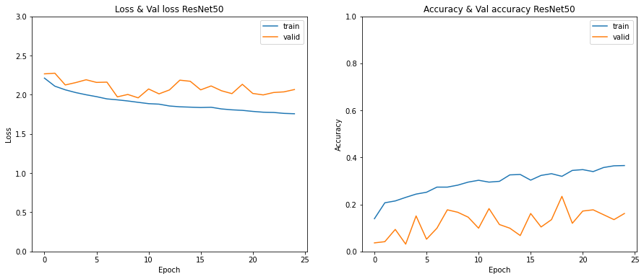
MobileNetV2
4. Describe your solution
Different other models have been trained in this project: custom models in order to try out how one can created them from scratch. Performances have increased from the first model (around 40%) to more than 60% in the last model before applying the transfer learning techniques.
Other models have also been trained (VGG16, ResNet50), but from the accuracy metric point of view, only MobileNetV2 has been able to outperform the other models in only 30 epochs reaching over 92% accuracy both for the accuracy on the training set and validation set.
The value of the recall metric using the MobileNetV2 model is also the highest value, over 90%: that means that the model is able to correctly classify, for each class, almost all the images that are feeded into it.
VGG16
ResNet50

Slide 15
4. Describe your solution
More closely, the numerical results are the following (using the hyperparameters shown):
Hyperparameters
batch_size = 16
loss = Categorical crossentropy
optimizer = Adam
learning_rate = 0.0001
*
*
* With min/maxAccuracy is meant w.r.t. the training set while fitting the model
As it is clear, MobileNetV2 outperforms the other two transfer model in only 30 epochs.

Slide 16
5. Comment positive and negative results of your solution
(rely on quantitative and qualitative observations)
Positive results (+)
Negative results (-)
Accuracy results obtained by MobileNetV2 and recall values are over 90%, as for the results on the test set;
MobileNetV2 is faster than other more complex models as VGG16 and ResNet50
The solution presented consider also a rejection class: the model is able to return a class that is not food; furthermore, another option that the model has is, in case the probability computed is lower than 50%, it can reply that is not able to provide a clear answer to the image feeded.
The amount of original images, less than a 1000, required Data Augmentation, that could be the reason why it performs very well, but it seems not able to reach an accuracy greater than 92% on the validation set.
Some images are difficult to recognize, also for a human being: for instance, in some images in the sushi folder, they contain both sushi and sashimi but the images itself are labeled as sushi. This can lead the model to perform not as its maximum capacity.
matrice di confusion dire che sushi è stato classificato meglio o peggio ddi sashimi. formulare ipotesi su cosa funziona e cosa non funziona, su cosa funzione meglio/peggio. questo discorso si fa con i numeri ma anche degli esempi specifici mostrando immagini nella presentaion
Notes:
Positive results:
The first positive results is shown by the accuracy values obtained by the MobileNetV2: the preprocessing, the Data Integration and Data Augmentation on the train set have been useful to let the model learn the necessary features to predict the test images. High accuracy is visible both on the training set, but also on the validation and test set, allowing to state that the model does not overfit/underfit.
The second positive result is derived from the model itself, with respect to the other ones: MobileNetV2 is faster than the VGG16 and the ResNet50 in obtaining in less epochs a high accuracy and high recall results.
The solution presented consider also a rejection class, in order to give to the model the possibility to return a class that is not food in case a different image is feeded into it. Furthermore, another option that the model has is, in case the probability computed is lower than 50%, to be able to reply that is not able to provide a clear answer to the image feeded.
Negative results:
The first negative result can be seen looking at the original images: the total amount of less than a 1000 and the need to apply Data Augmentation, can be considered as the reason why the model perform very well, but it is not able to reach more than 92% of accuracy on the validation set and, by consequence, around 90% on the test set.
For some of the images it is difficult, sometimes also for a human, to understand the difference between certain classes: for instance, sushi and sashimi. In some images in the sushi folder, some images contains both sushi and sashimi but the images itself are labeled as sushi. This can lead the model to perform not as its maximum capacity.
The solution presented required using Google Colab in addition to Google Drive. Without the use of the GPU (often not enough to train all the custom model and the one used for transfer learning, the VGG16 and the ResNet ones were difficult to train on it, often leading to the session to crash and the need to restart again. The possibility to train all the models on your own machine could be an improvement.

Slide 17
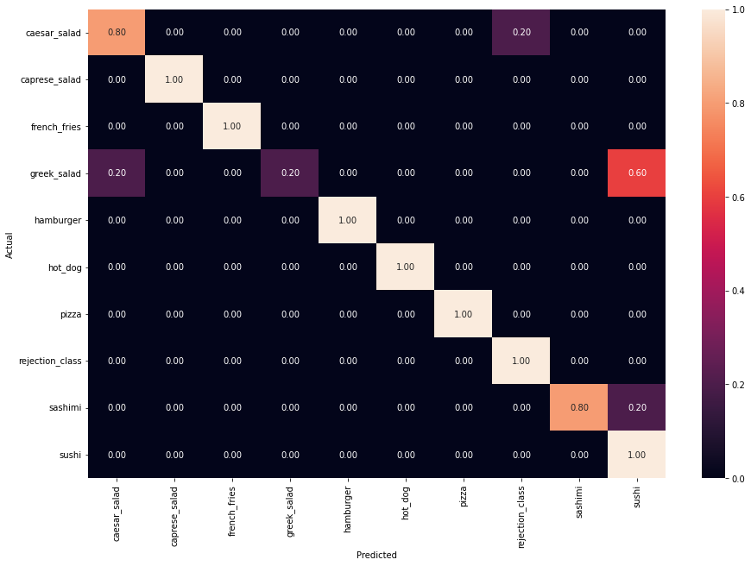
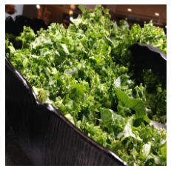
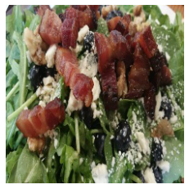
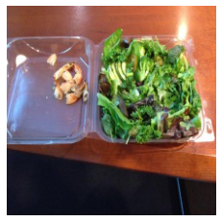
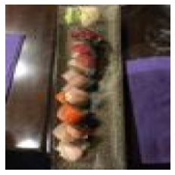
5. Comment positive and negative results of your solution
(rely on quantitative and qualitative observations)
Negative results (-)
In fact, checking the confusion matrix it is possible
to see the mistakes that the model has done. Specifically, in case of the Greek salad, the Caesar salad and sashimi, the model was, sometimes, not able to recognize the class correctly.
- One of the reasons could be the bad quality of the image itself or a very difficult way of distinguish between the two types of salad, as it is possible to see from the images in this slide.
Rejection class
Correct: caesar salad
Caesar salad
Correct: greek salad
Not recognised!
Correct: greek salad
Sushi
Correct: sashimi
Notes:
Positive results:
The first positive results is shown by the accuracy values obtained by the MobileNetV2: the preprocessing, the Data Integration and Data Augmentation on the train set have been useful to let the model learn the necessary features to predict the test images. High accuracy is visible both on the training set, but also on the validation and test set, allowing to state that the model does not overfit/underfit.
The second positive result is derived from the model itself, with respect to the other ones: MobileNetV2 is faster than the VGG16 and the ResNet50 in obtaining in less epochs a high accuracy and high recall results.
The solution presented consider also a rejection class, in order to give to the model the possibility to return a class that is not food in case a different image is feeded into it. Furthermore, another option that the model has is, in case the probability computed is lower than 50%, to be able to reply that is not able to provide a clear answer to the image feeded.
Negative results:
The first negative result can be seen looking at the original images: the total amount of less than a 1000 and the need to apply Data Augmentation, can be considered as the reason why the model perform very well, but it is not able to reach more than 92% of accuracy on the validation set and, by consequence, around 90% on the test set.
For some of the images it is difficult, sometimes also for a human, to understand the difference between certain classes: for instance, sushi and sashimi. In some images in the sushi folder, some images contains both sushi and sashimi but the images itself are labeled as sushi. This can lead the model to perform not as its maximum capacity.
The solution presented required using Google Colab in addition to Google Drive. Without the use of the GPU (often not enough to train all the custom model and the one used for transfer learning, the VGG16 and the ResNet ones were difficult to train on it, often leading to the session to crash and the need to restart again. The possibility to train all the models on your own machine could be an improvement.

Slide 18
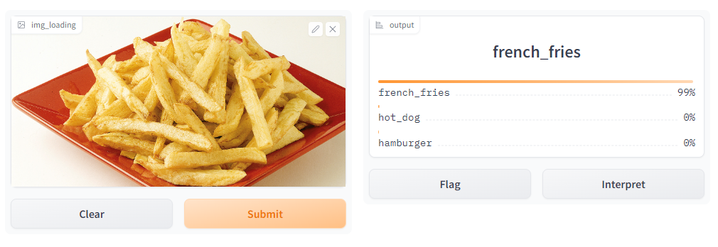
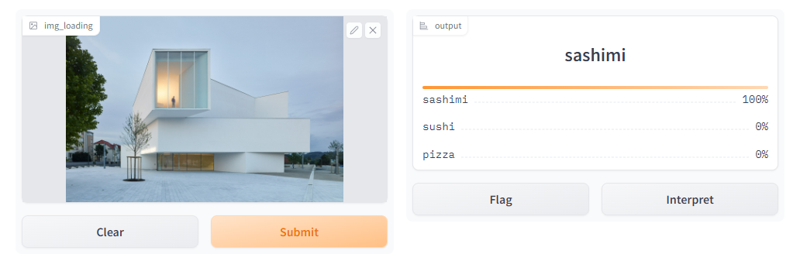
5. Comment positive and negative results of your solution
(rely on quantitative and qualitative observations)
Negative results (-)
One last negative result comes from the deployment notebook. Even though for most of the images the model run well, for some of them is incapable to give a correct prediction or, at least, to state that is not able to give a certain output. Instead, it seems confident in giving a prediction amongst the food categories, like in the example shown here.
Notes:
Positive results:
The first positive results is shown by the accuracy values obtained by the MobileNetV2: the preprocessing, the Data Integration and Data Augmentation on the train set have been useful to let the model learn the necessary features to predict the test images. High accuracy is visible both on the training set, but also on the validation and test set, allowing to state that the model does not overfit/underfit.
The second positive result is derived from the model itself, with respect to the other ones: MobileNetV2 is faster than the VGG16 and the ResNet50 in obtaining in less epochs a high accuracy and high recall results.
The solution presented consider also a rejection class, in order to give to the model the possibility to return a class that is not food in case a different image is feeded into it. Furthermore, another option that the model has is, in case the probability computed is lower than 50%, to be able to reply that is not able to provide a clear answer to the image feeded.
Negative results:
The first negative result can be seen looking at the original images: the total amount of less than a 1000 and the need to apply Data Augmentation, can be considered as the reason why the model perform very well, but it is not able to reach more than 92% of accuracy on the validation set and, by consequence, around 90% on the test set.
For some of the images it is difficult, sometimes also for a human, to understand the difference between certain classes: for instance, sushi and sashimi. In some images in the sushi folder, some images contains both sushi and sashimi but the images itself are labeled as sushi. This can lead the model to perform not as its maximum capacity.
The solution presented required using Google Colab in addition to Google Drive. Without the use of the GPU (often not enough to train all the custom model and the one used for transfer learning, the VGG16 and the ResNet ones were difficult to train on it, often leading to the session to crash and the need to restart again. The possibility to train all the models on your own machine could be an improvement.

Slide 19

6. Describe alternative (possibly failed) experiments
One attempt was made in order to apply GridSearchCrossValidation on the deeper Model V04, with the goal of finding out which are the best permutations of parameters that perform better on this data.
Even though the results showed the usage of a learning_rate = 0.001 and an activation_function = LeakyReLU, multiple experiments with this hyperparameters have shown that the best set of them is the one that involves a ReLU activation function and a learning rate of 0.0001.
This is the reason why this hyperparameters have been chosen for the Transfer Learning with the MobileNetV2 architecture.
Adjust icons created by Good Ware - Flaticon

Slide 20
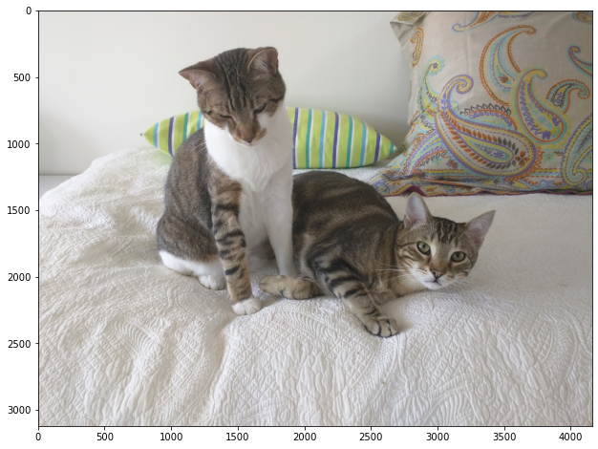
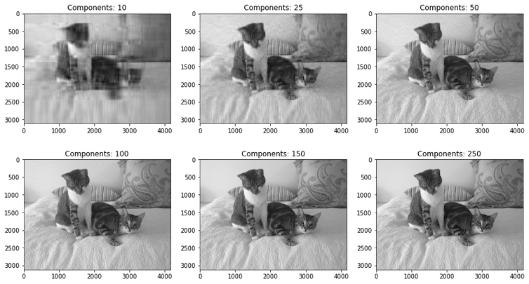
Original image
Size: (3120, 4160,3)
6. Describe alternative (possibly failed) experiments
An alternative experiment involved the usage of the Principal Component Analysis in conjunction with Transfer Learning using MobileNetV2 architecture.
The idea behind that experiment was to reduce the number of parameters involved in the model (considering only the images, after resizing them by 224x224, the number of parameter in total has risen to 50.176) that, in total, the model has to learn in order to predict the new image.
The experiment succeeded: in fact, during the training phase, the fitting speed was much higher than the traditional methods. Nevertheless, the final accuracy was around 10% lower than when using the full amount of parameters with MobileNetV2 architecture and Transfer Learning (around 80%)
With PCA we only need to use 54 of the original 3120 components to explain 95% of the variance in the image.

Slide 21
INSERIRE LINK LOCALHOST A DEPLOYMENT → GRADIO. AGGIUNGERE LINK A LOCALHOST PER GRADIO CAMBIANDO LA TOP5 ACCURACY CON LA TOP3 ACCURACY! E MODIFICA SLIDE SUI CMMENTI POSITIVI/NEGATIVI DELLA TUA SOLUZIONE
fOCALIZZARSI MOLTO DI PIù SUL SUDORE PRECEDENTE ALLA MODELLAZIONE FINALE E ALL’OUTPUT.
RICORDA CHE HAI 1 SLIDE PER MINUTO, DOVRESTI RESTARE NELLE 15 SLIDE MASSIMO!! IN TOTALE HAI 10 MINUTI DI PRESENTAZIONE!

Slide 22
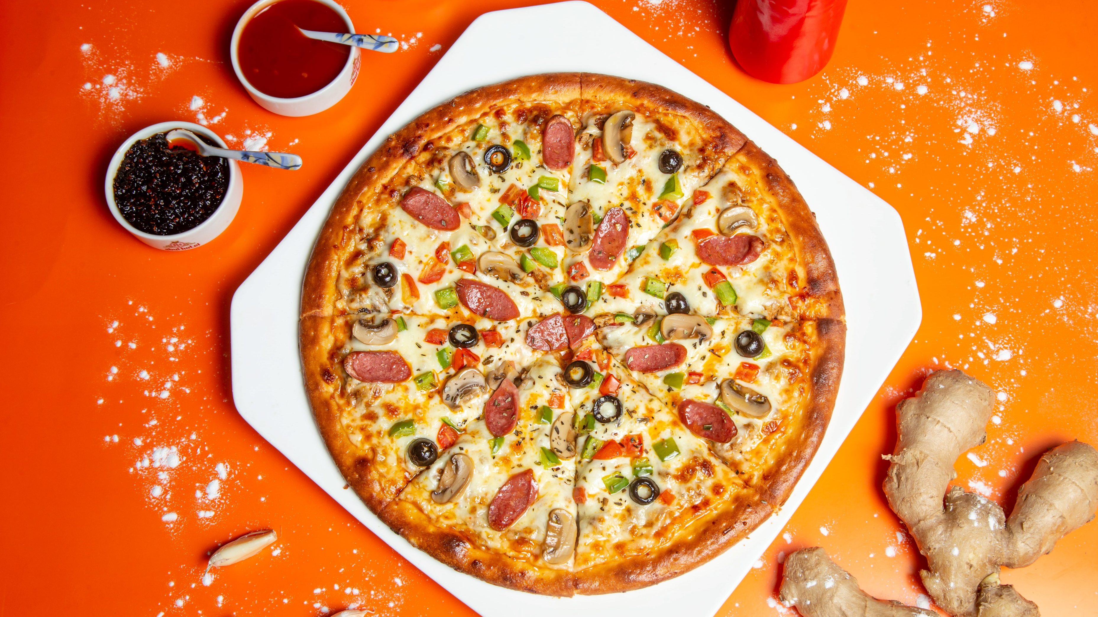
THANK you FOR your ATTENTION!
Foto di Shourav Sheikh su Unsplash

Slide 23
REFERENCES
DATASET:
https://de.mathworks.com/help/deeplearning/ug/data-sets-for-deep-learning.html
PAPER:
https://link.springer.com/content/pdf/10.1007/978-3-319-23222-5_41.pdf
http://madima.org/wp-content/uploads/2017/11/12-A0-ICIAP-foodCNN-poster.pdf
https://boa.unimib.it/bitstream/10281/206401/4/CNN-based%20features_post-print.pdf
https://ieeexplore.ieee.org/stamp/stamp.jsp?tp=&arnumber=8228338
https://ieeexplore.ieee.org/stamp/stamp.jsp?tp=&arnumber=8550005
https://arxiv.org/pdf/1612.00983.pdf
https://www.irjet.net/archives/V9/i3/IRJET-V9I3368.pdf
https://www.irjet.net/archives/V9/i1/IRJET-V9I131.pdf
https://image-net.org/static_files/papers/imagenet_cvpr09.pdf
https://medium.com/analytics-vidhya/indian-food-image-classification-using-transfer-learning-b8878187ddd1
https://wordnet.princeton.edu/
https://github.com/abhijeet3922/Food-Classification-Task-Transfer-learning/blob/master/Food_classification_transfer_learning_finetuningVGG16_30072019.ipynb
https://www.image-net.org/
https://towardsdatascience.com/image-compression-using-principal-component-analysis-pca-253f26740a9f
https://www.kaggle.com/code/poigal/transfer-learning-feature-extraction-and-pca
https://github.com/Murgio/Food-Recipe-CNN
https://www.dataknowsall.com/imagepca.html
https://www.kaggle.com/code/themlphdstudent/food-classification-using-inceptionv3

